Slide 1
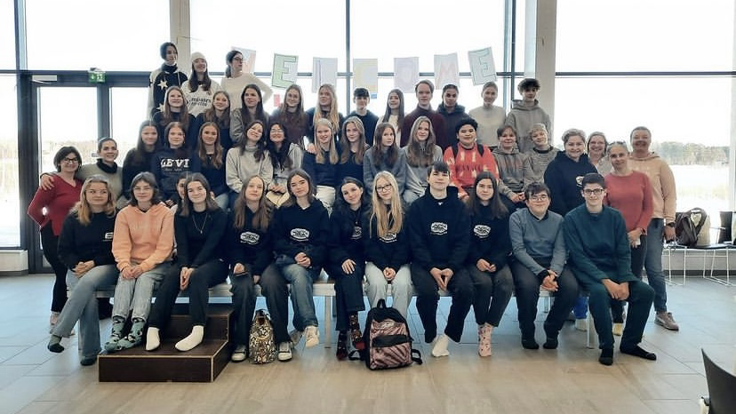
Erasmus + week
Made by Linn, Ina, Oscar, Leire, Maria, Marylou and Zuzanna

Slide 2
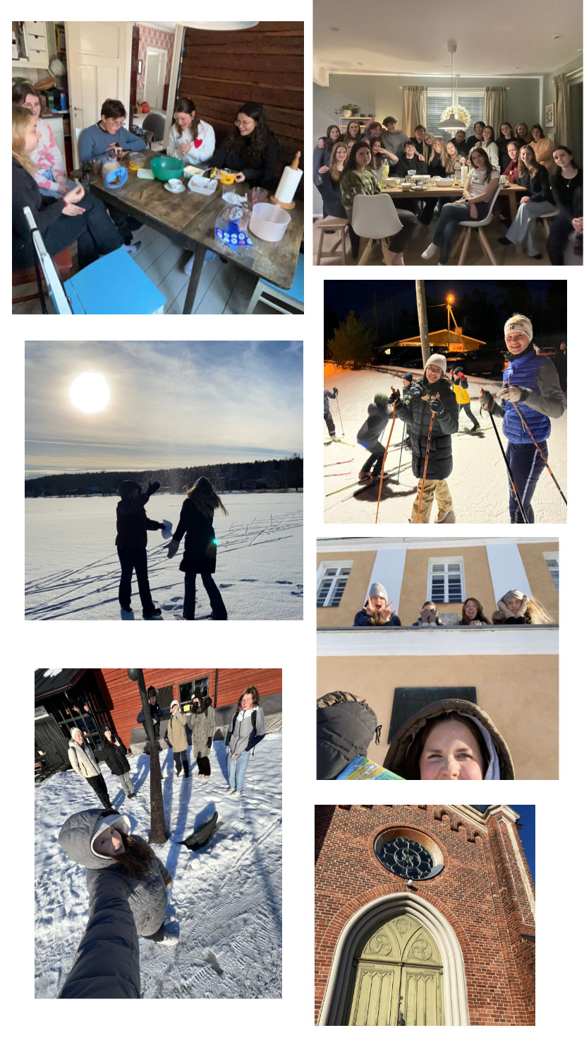
Monday 12.2
Yoga
Amazing Race
Skiing
Dinner

Slide 3
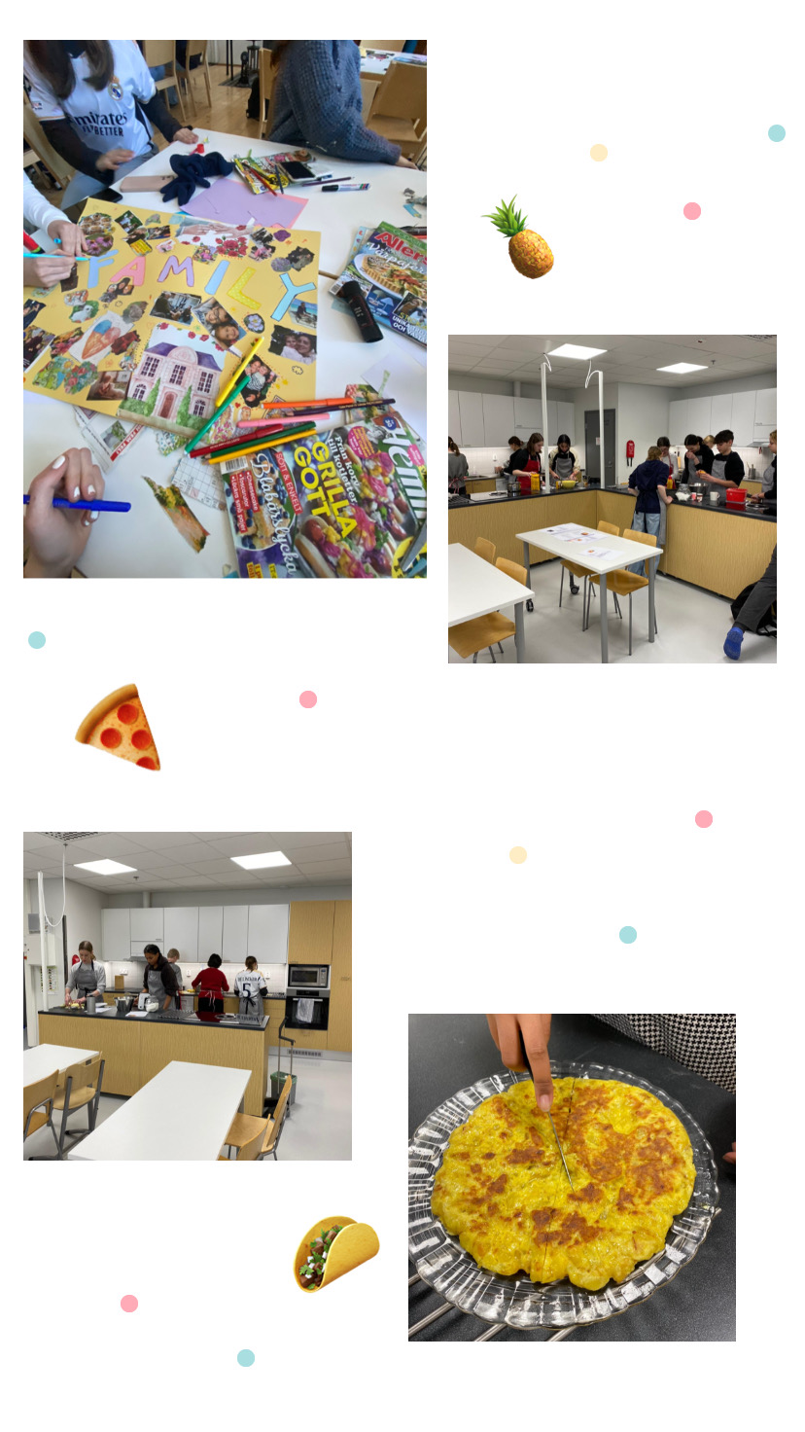
Tuesday 13.2
Posters
Baking and cooking
Pizza evening

Slide 4
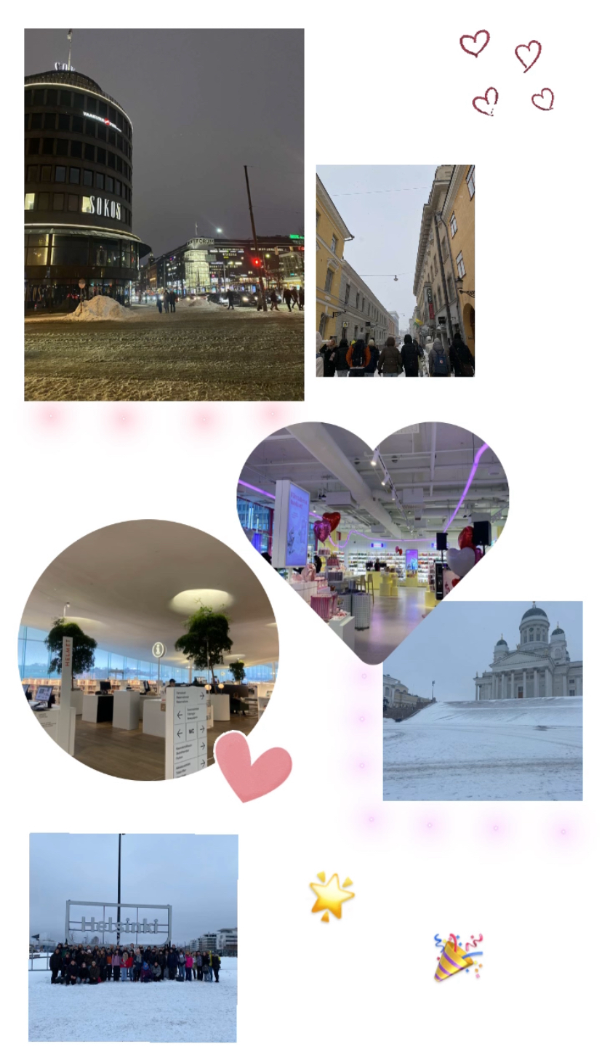
Wednesday 14.2
Helsinki
Sveaborg
Shopping

Slide 5
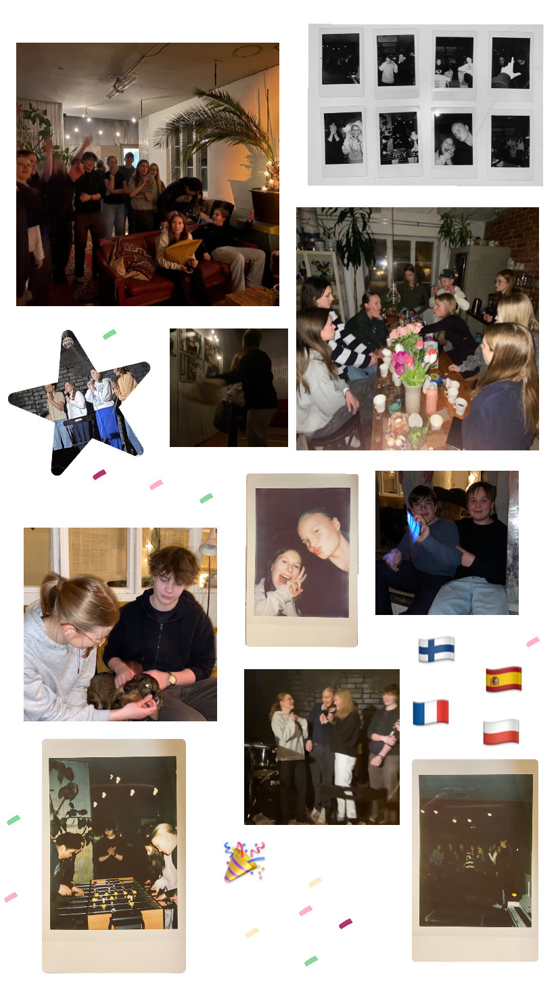
Thursday 15.2
Ice skating
Ordinary lesson
Wellbeing workshop
Karaoke night

Slide 6
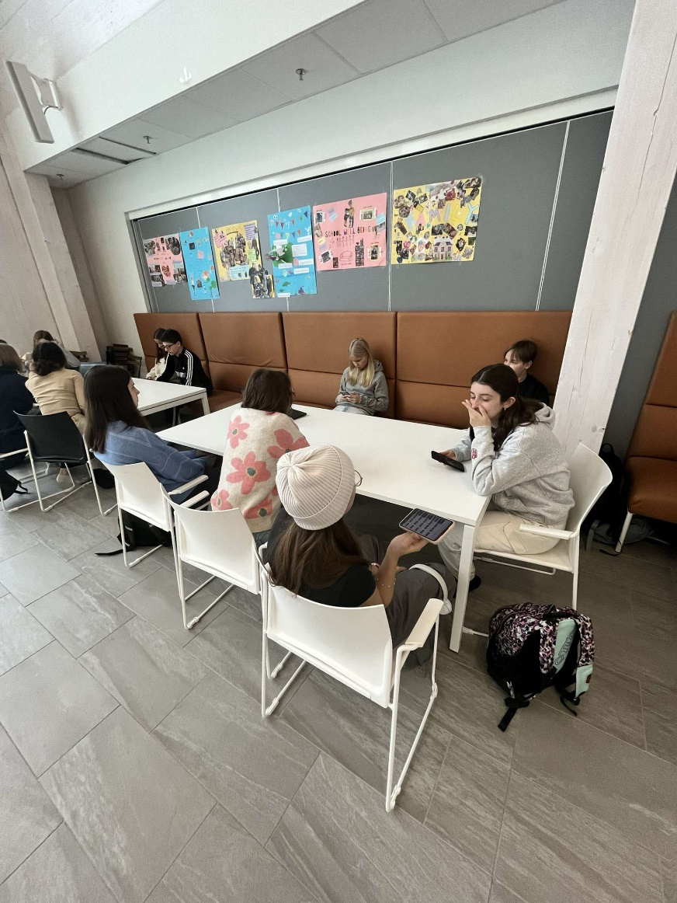
Friday 16.2
Evalution of the week
Gamlas dans
Outdoor activities

