Slide 1
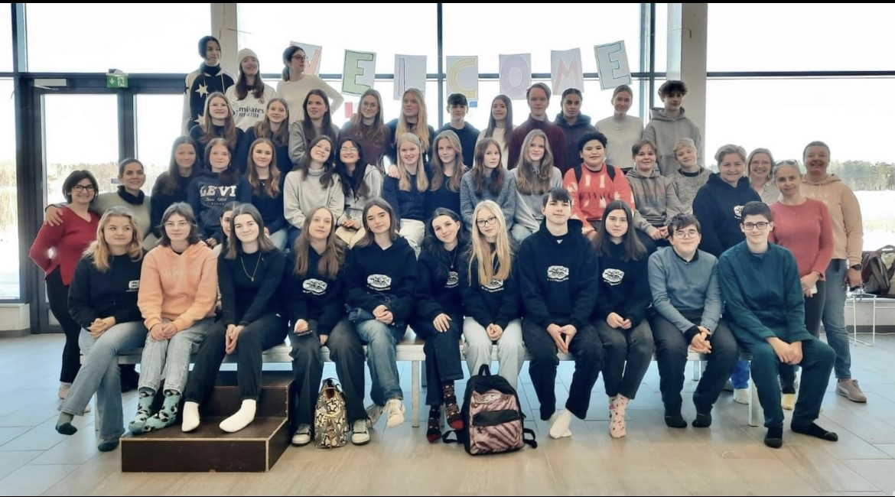
Erasmus⁺
Misan, Antonio, Angeline, Adele, Amelia and Sofia

Slide 2
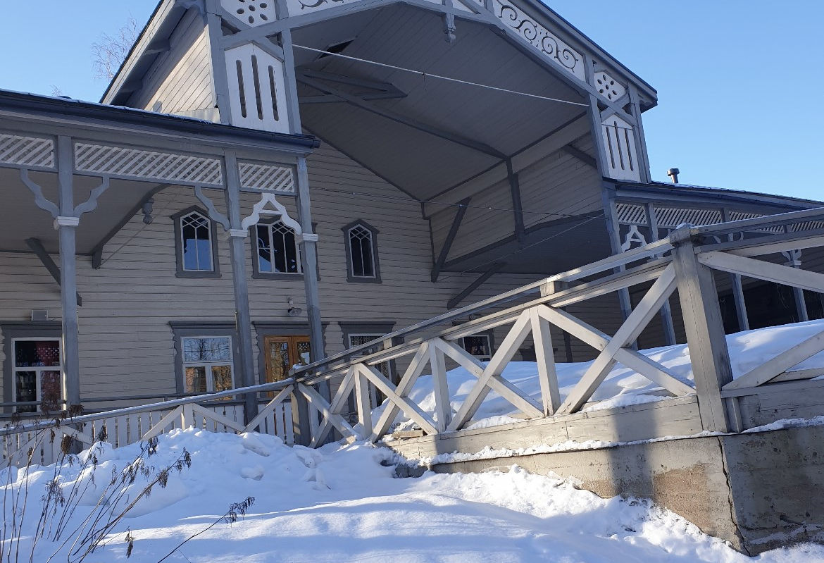
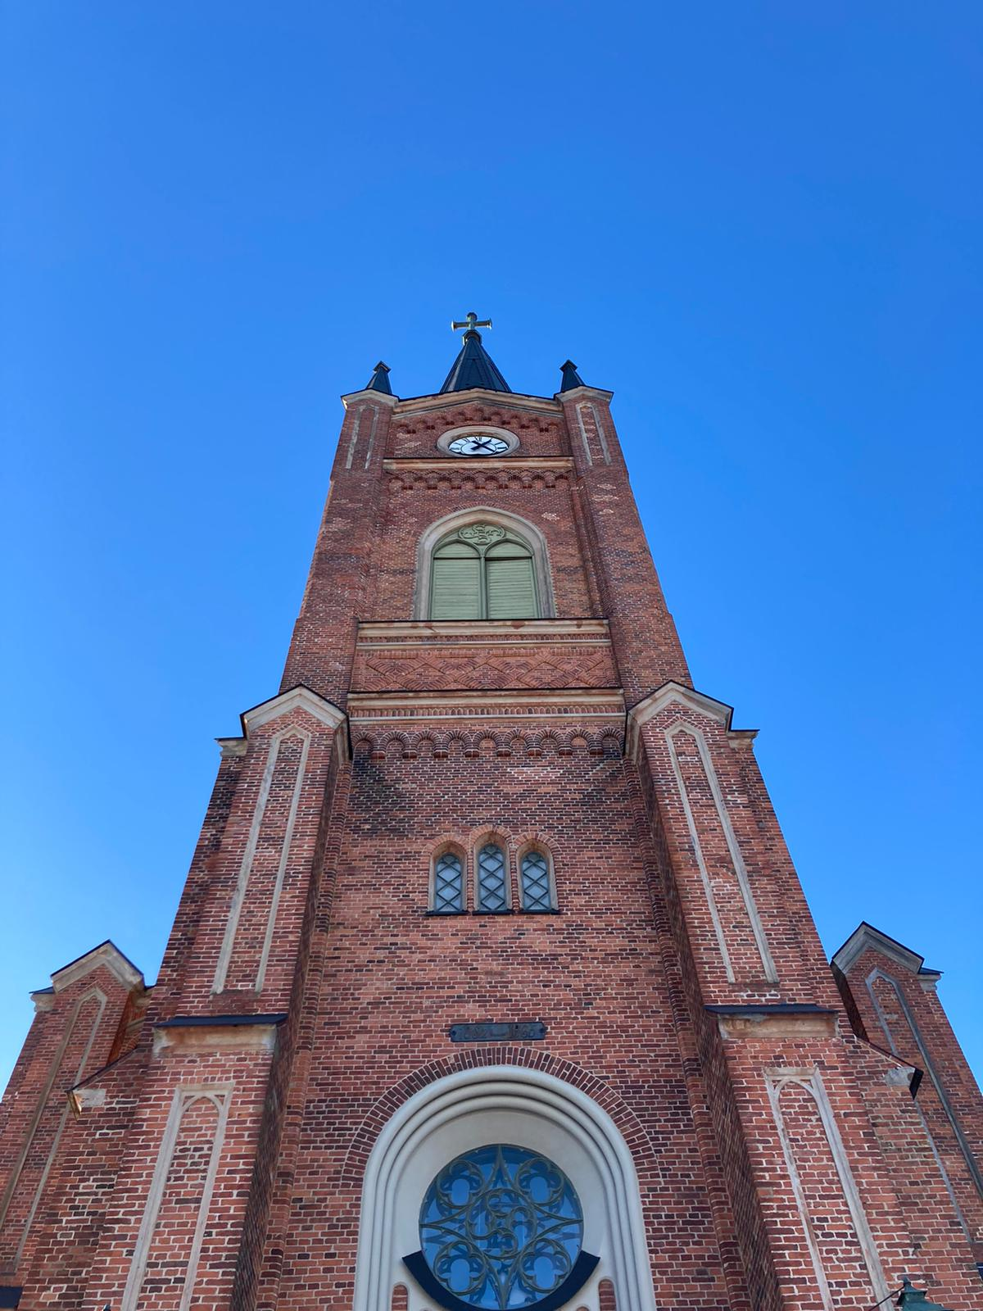
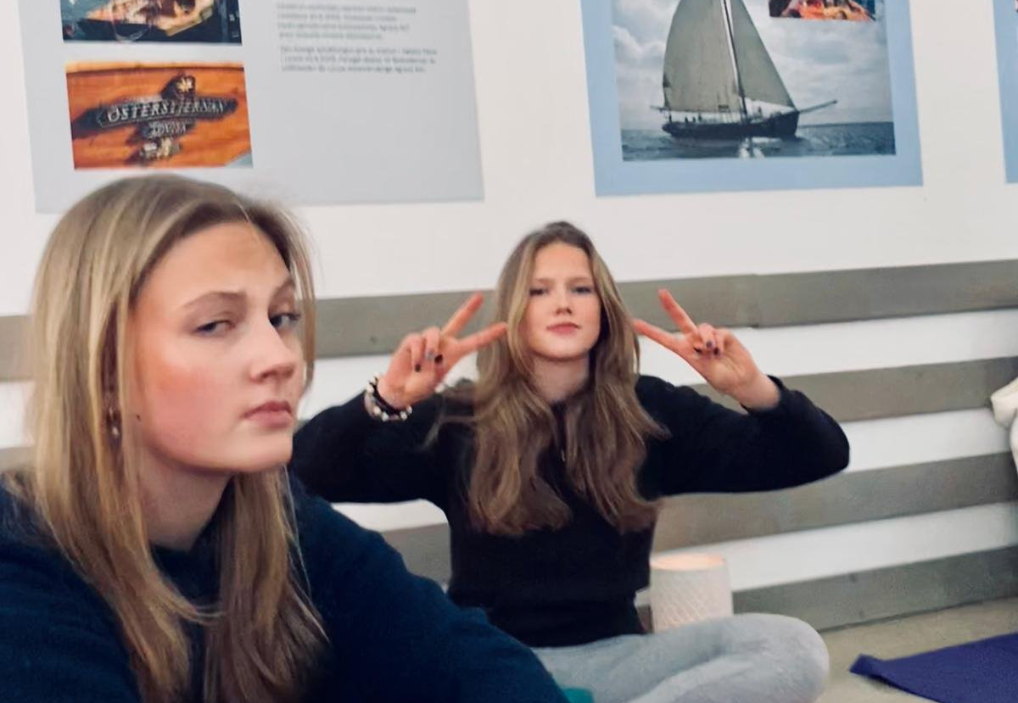
Monday
On Monday we got to know the group with games
We had yoga
Town tour

Slide 3
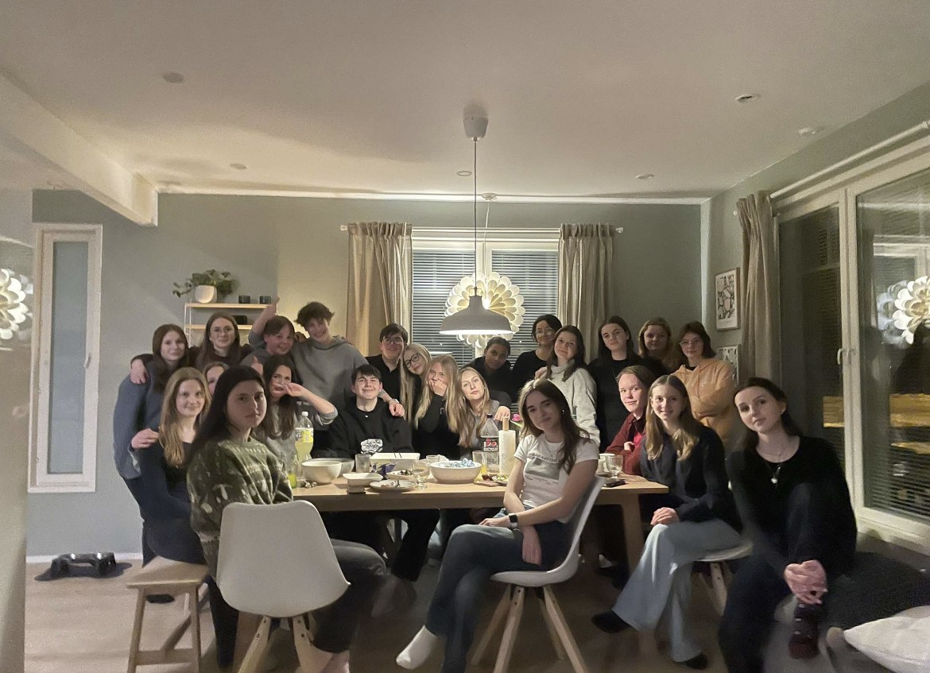
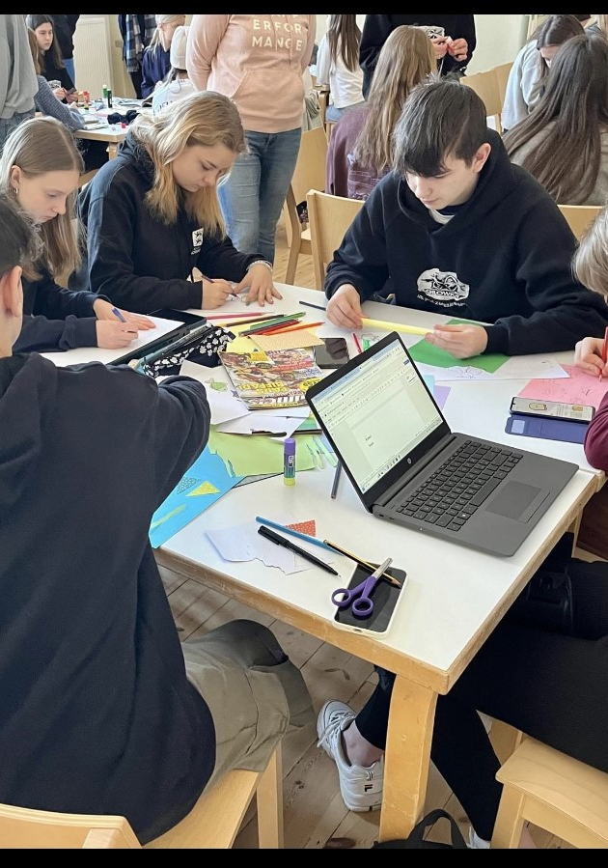
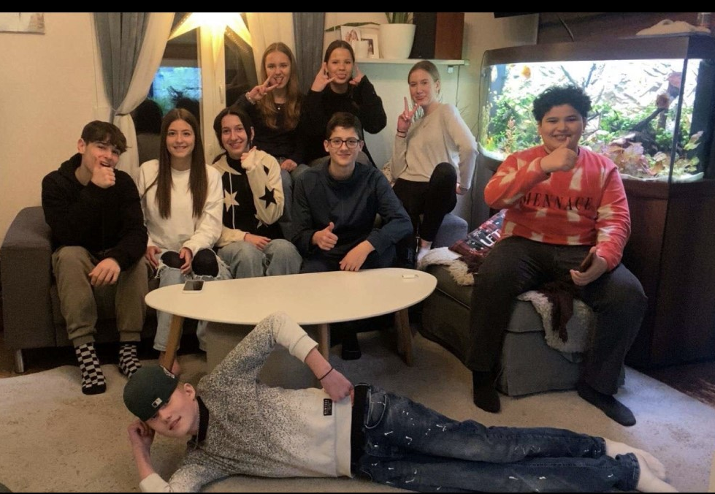
Tuesday
We made different posters
We had pizza and taco night

Slide 4
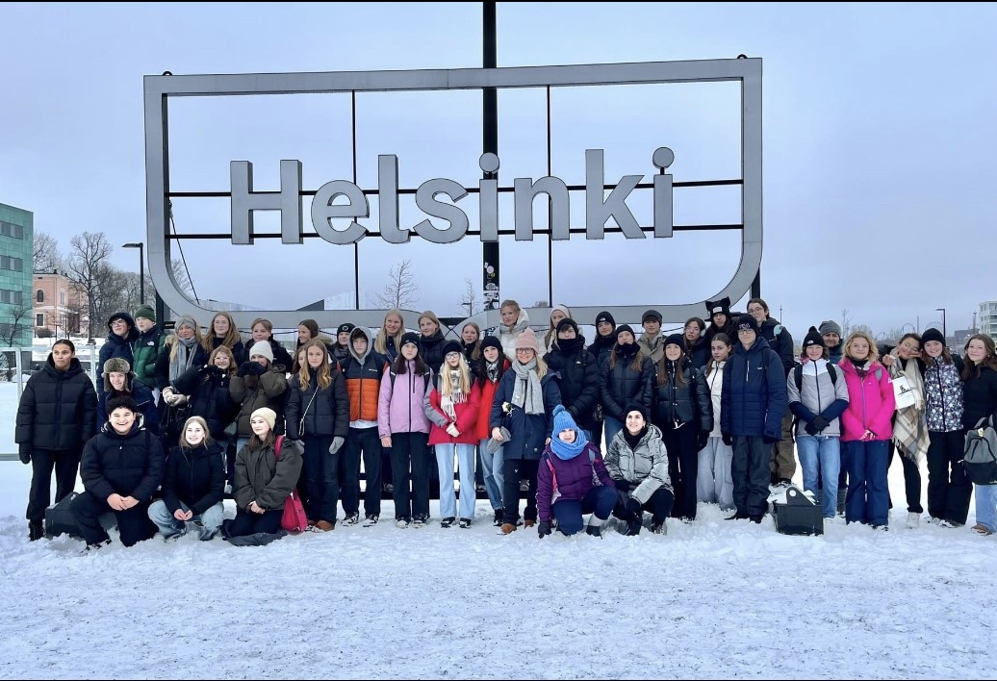
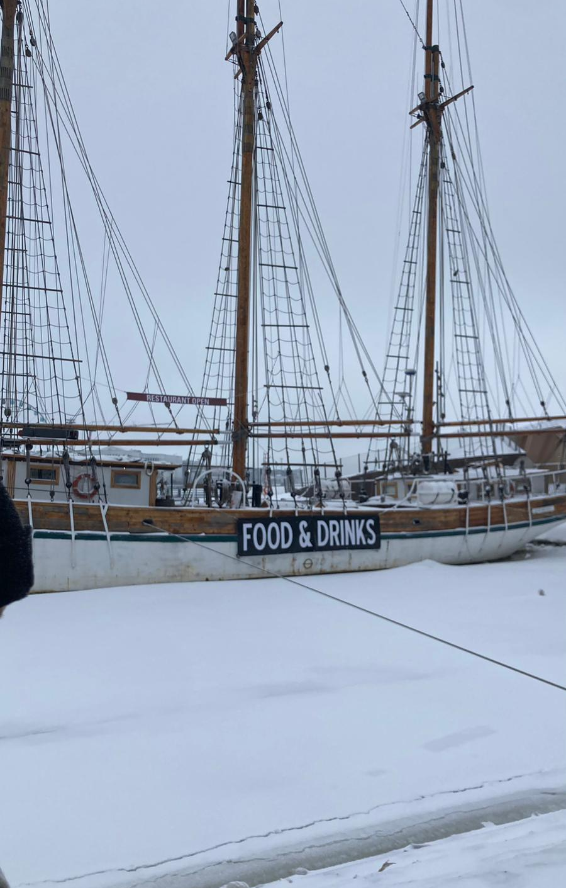
Wednesday
A daytrip to Helsinki
We went to Suomenlinna
We ate at a restaurant, and we went shopping

Slide 5
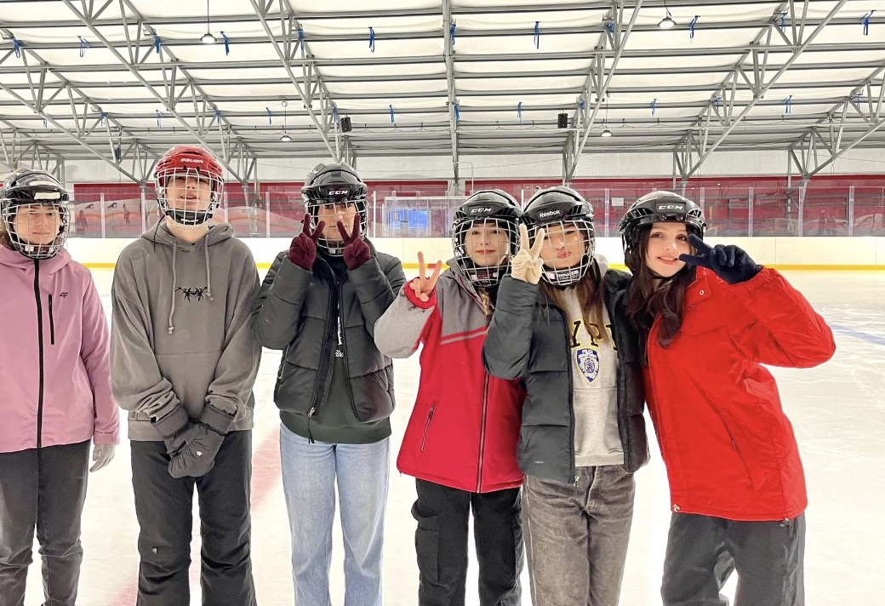
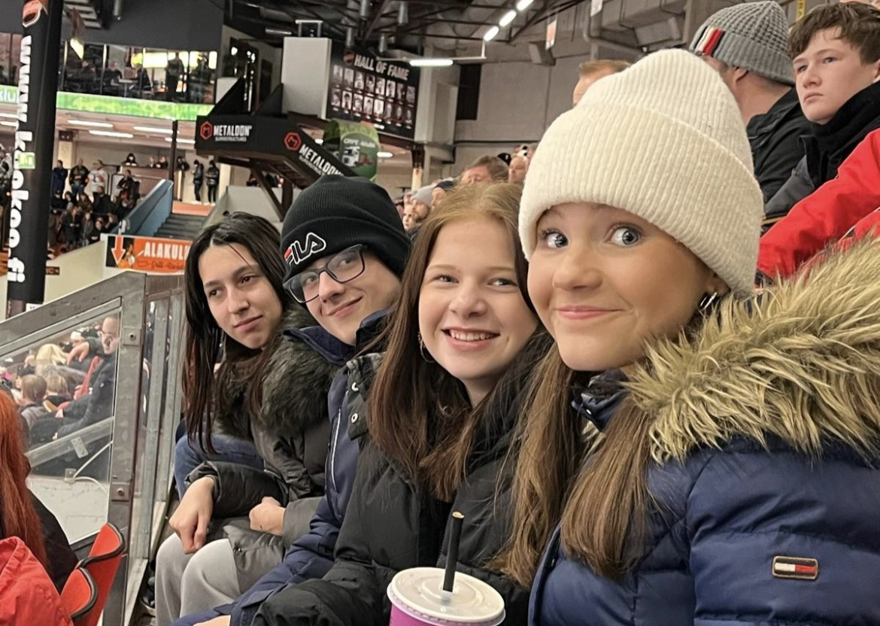
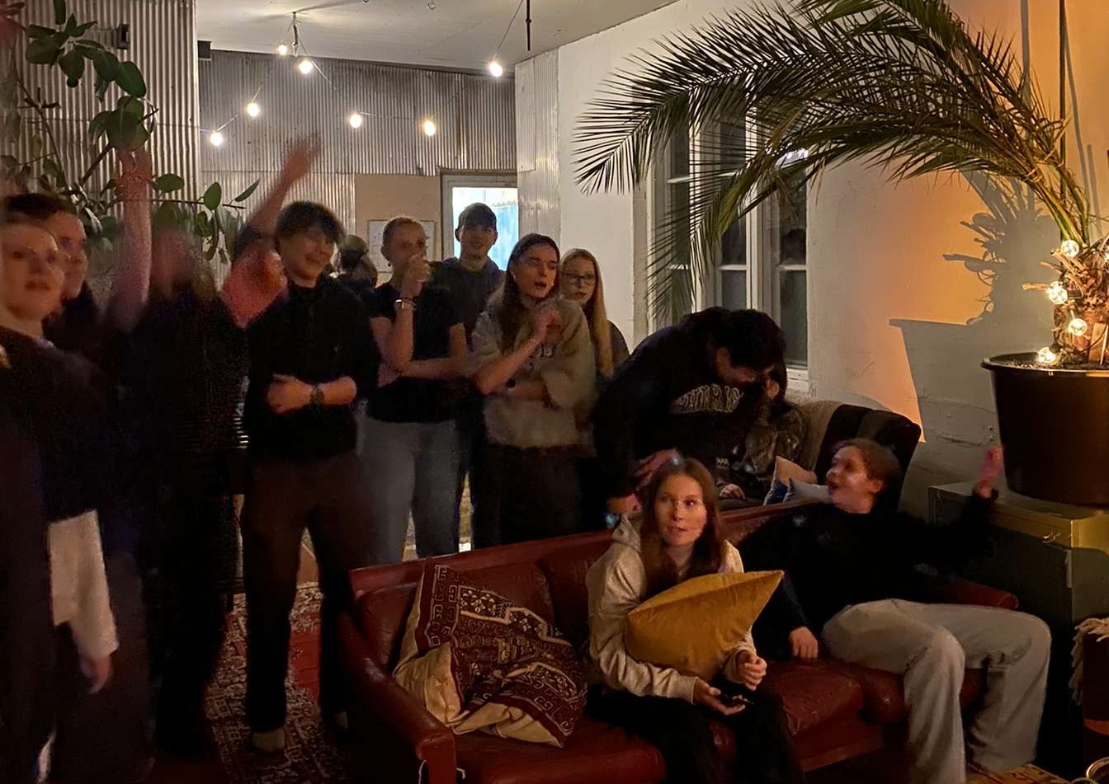
Thursday
Ice skating and Penkkis
Karaoke evening
Ice hockey game

